Slide 1


Project Title -AIRBNB Hotel Booking Analysis
NAME :TUSHAR KAPOOR

Slide 2

PROBLEM STATEMENT
Airbnb generates massive booking data containing details about reservations, customer preferences, cancellations, and seasonal demand. Without systematic exploratory data analysis (EDA), it is difficult to extract meaningful insights to understand booking trends, customer behavior, and factors affecting cancellations. Conducting EDA on Airbnb hotel booking data will help uncover hidden patterns, optimize resource allocation, and support data-driven decision-making for improved business outcomes

Slide 3
Project Description Objective: Analyze Airbnb NYC listings to understand supply composition, pricing patterns, availability, reviews, and host characteristics across boroughs and neighborhoods. Data: ~83k rows, 26 columns; key fields include borough/neighborhood, room_type, lat/long, price_$, service_fee_$, minimum_nights, number_of_reviews, reviews_per_month, host listings count, availability_365, last_review, house_rules, license. Loading/Cleaning: Fixed Excel import, standardized numeric price/service fee fields, parsed dates for last_review, retained categorical labels; recommend relative paths and a missingness table for full reproducibility. Descriptives: Price and fee are right‑skewed with meaningful outliers; availability and minimum_nights show long tails; review cadence varies widely by area and room type. Supply mix: Inventory is dominated by Entire home/apt and Private room; Brooklyn and Manhattan account for the largest share, followed by Queens, Bronx, Staten Island. Pricing insights: Median prices are higher in Manhattan/Brooklyn with large intra‑borough spread; service fees generally scale with price but are not strictly linear.

Slide 4

WHO ARE THE END USERS?
Hosts: individual and professional property owners/operators using insights to set prices, minimum nights, availability, and policies.
Guests: travelers comparing neighborhoods, room types, and price ranges to optimize stay value and availability.
Platform teams: marketplace, trust & safety, and support teams monitoring supply mix, pricing fairness, reviews cadence, and policy compliance.
Revenue and pricing analysts: analysts building pricing rules, fee strategies, and promotional targets by borough, neighborhood, and room type.
City regulators and tourism boards: stakeholders assessing supply concentration, licensing, and neighborhood impact for policy decisions.
Investors and property managers: users evaluating performance benchmarks, occupancy proxies, and expansion opportunities across micro‑markets.

Slide 5

Technology Used
Python 3.x for data analysis scripting
Jupyter Notebook for interactive exploration and reporting
pandas for data loading, cleaning, transformation, and summaries
NumPy for numerical operations and arrays
seaborn and Matplotlib for statistical visualizations (histograms, KDE, boxplots, heatmaps, scatter)
SciPy (trim_mean, Spearman/Pearson correlation, IQR utilities) for basic statistics
Plotly Express (optional) for interactive charts
datetime/pandas to_datetime for parsing and using date fields
Git/GitHub (optional) for version control and collaboration

Slide 6
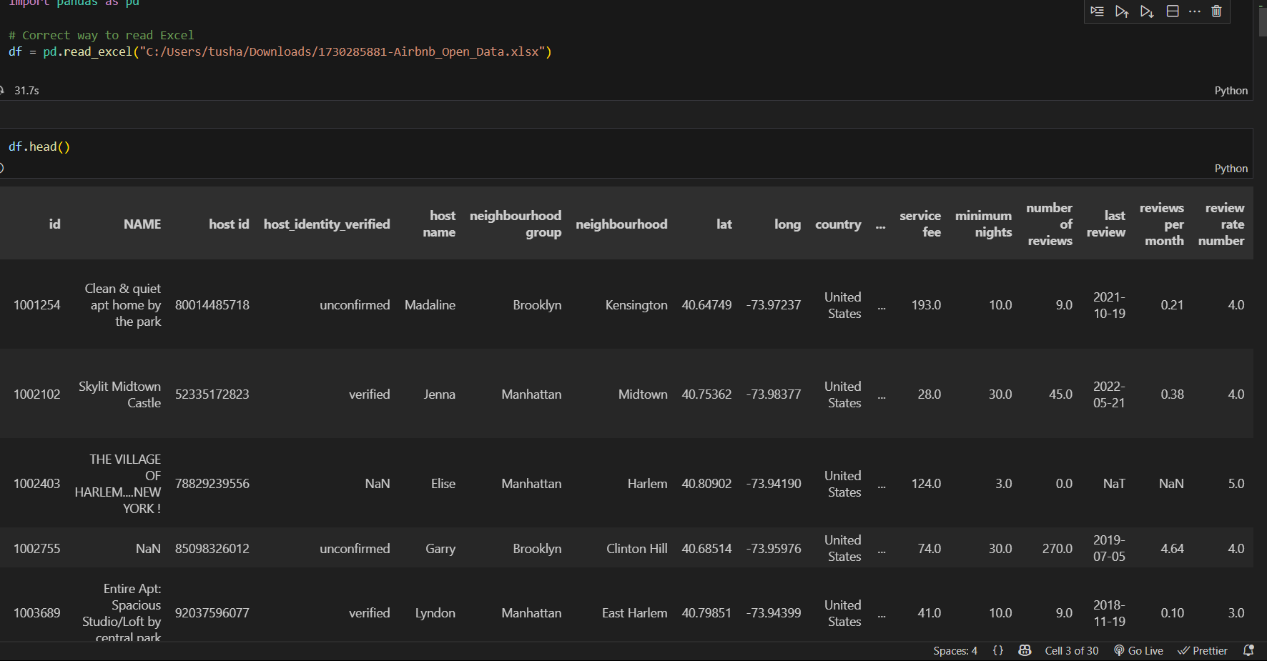
RESULTS1
Demo Link

Slide 7
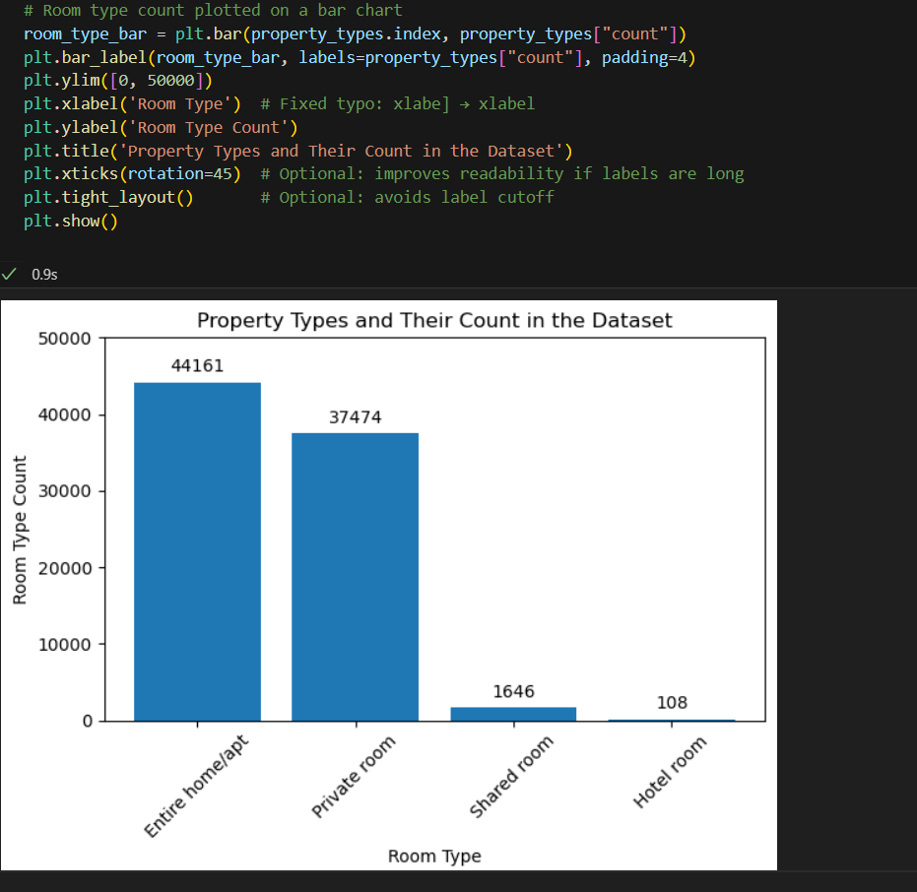
RESULTS2
[Add screen shots of your code or Chart(s) ]
Demo Link

Slide 8
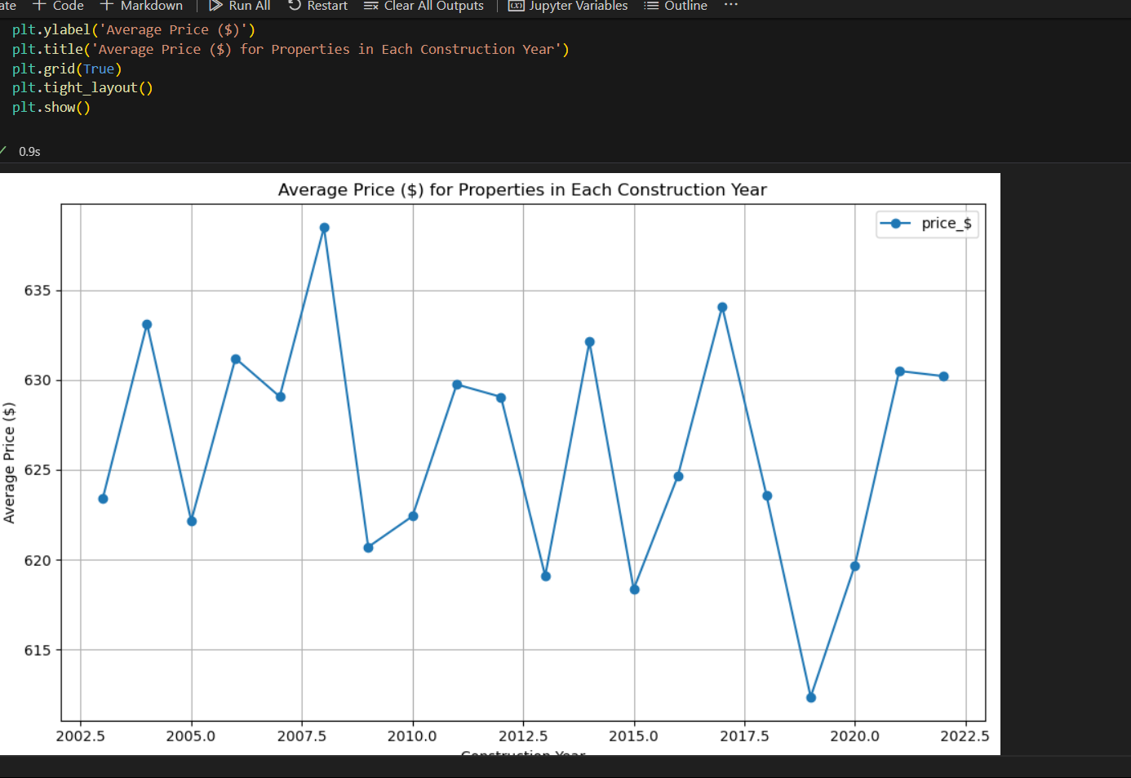
RESULTS3
[Add screen shots of your code or Chart(s) ]
Demo Link

Slide 9
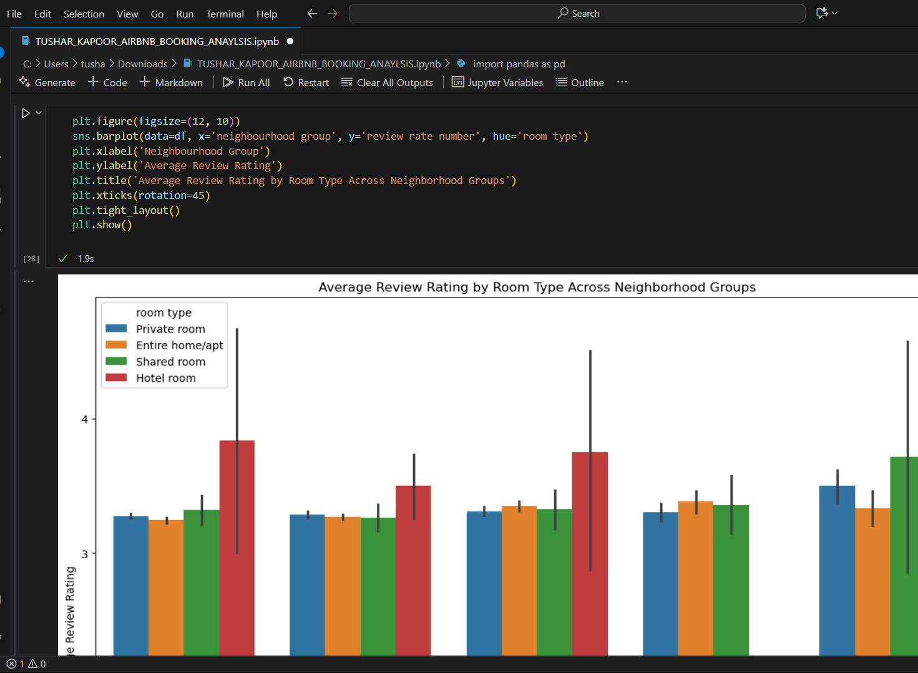
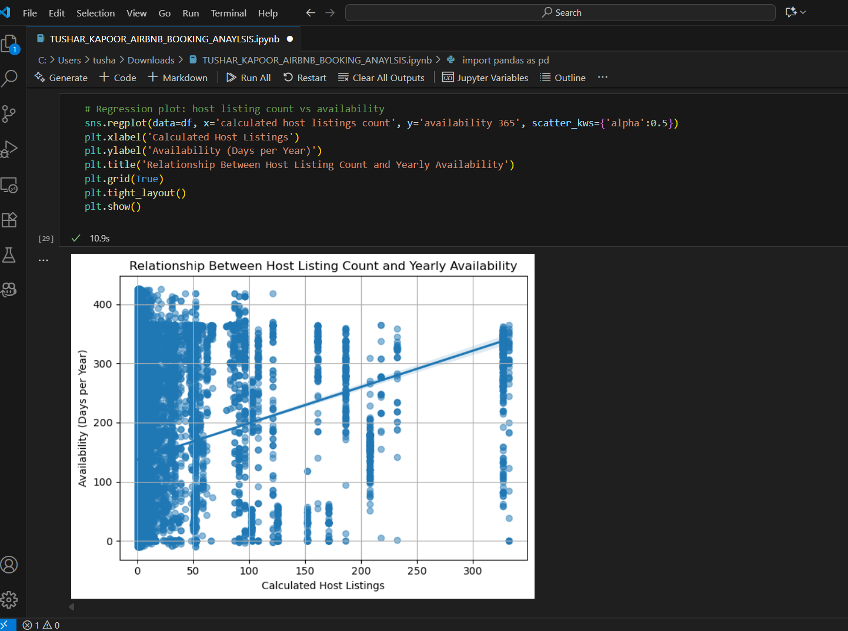
RESULTS4
[Add screen shots of your code or Chart(s) ]
Demo Link

Slide 10
GitHub repository
https://github.com/Tusharkapoor-oop/VOIS_AICTE_Oct2025_TUSHAR-KAPOOR
Demo Link

Slide 11
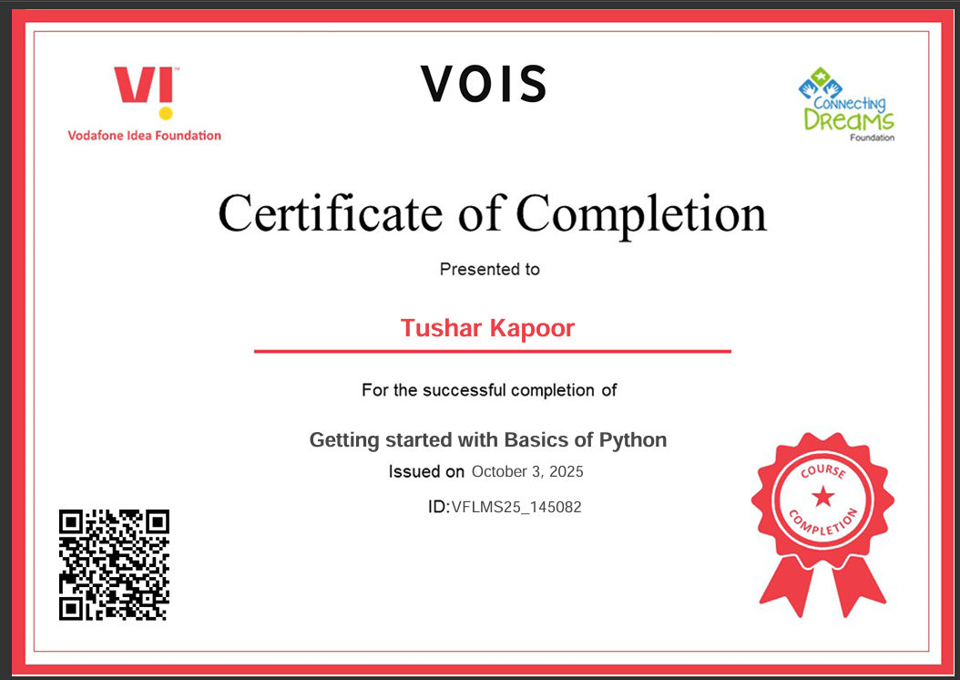
Getting started with Basics of Python Certificate

Slide 12
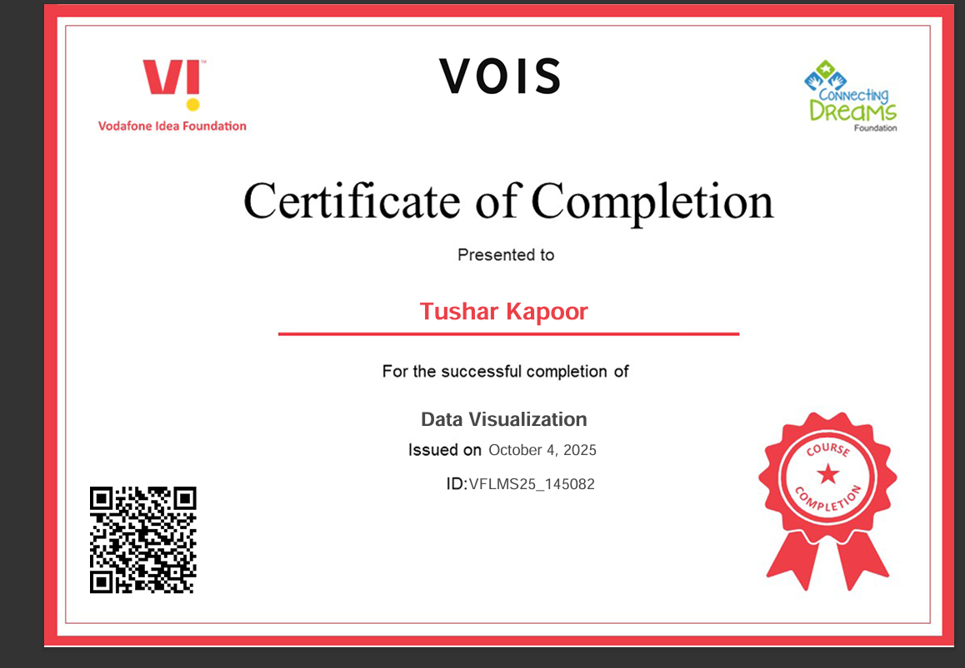
Data Visualization Certificate

Slide 13
Thank you
.
.

